Slide 1
DSS-28 IMPLEMENTATION
SYSTEM BLOCK DIAGRAM
02/05/07

Slide 2
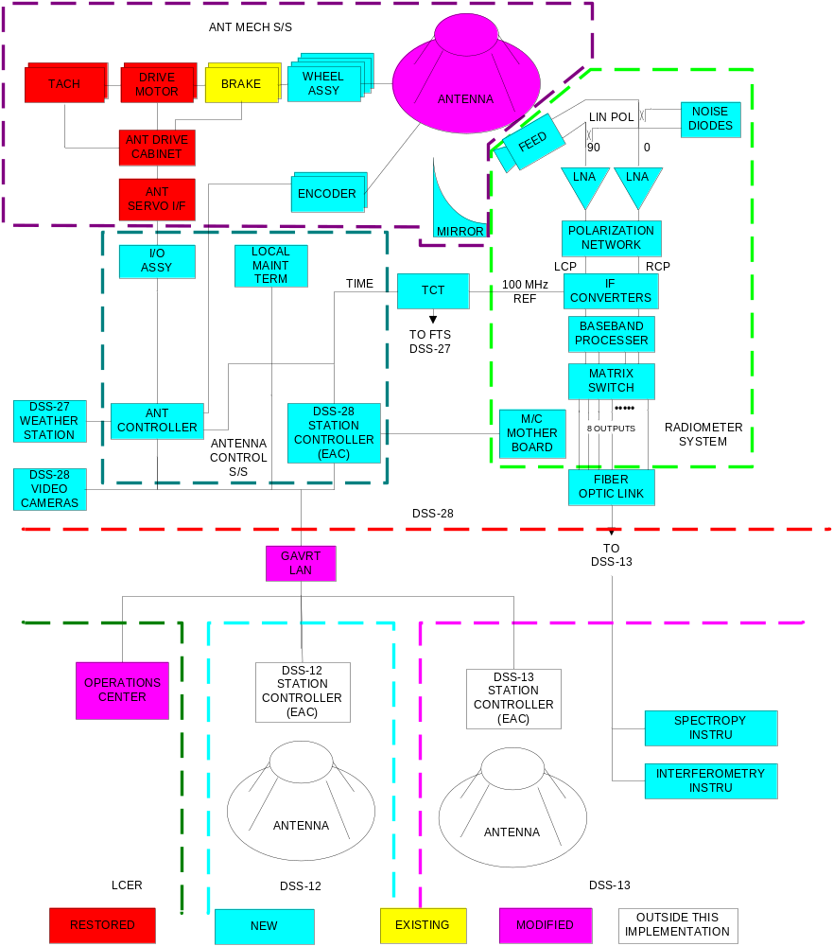
DSS-28 FUNCTIONAL SYSTEM BLOCK DIAGRAM

